Slide 1


INSTITUTE FOR ADVANCED COMPUTING AND SOFTWARE DEVELOPMENT AKURDI, PUNE Implementation of HIDS Using OSSEC (Security)
GROUP NO: 12
Neha kulkarni (233422)
Pratiksha Girnale (233434)
PROJECT GUIDE CENTRE COORDINATOR
Mr. Kartik Awari Mr. Rohit Puranik

Slide 2
Introduction
OSSEC (Open Source HIDS Security) is a monitoring tool used to detect intrusion
Aim of this project is to detect the problem of brute force attacks, unauthorized file modification, rootkit installation with the help of log-based intrusion detection, file integrity monitoring, active response, rootkit detection and to meet specific compliance requirements.
. It runs on most operating systems including Linux, Windows etc.

Slide 3
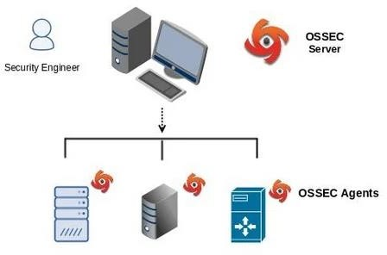

Slide 4
Why OSSEC ?
Open-Source
log analysis
Easy to install
Scalable (client/server architecture)
Easy to customize (rules and config in xml format)

Slide 5
Host-Based Intrusion Detection
HIDS stands for Host-based Intrusion Detection System.
HIDS focuses on protecting a single host by examining its system logs, files, configurations, and network traffic for any unusual or suspicious patterns that might indicate a security breach.
An HIDS detects events on a server or workstation and can generate alerts.

Slide 6
Key Benefits
Compliance Requirements
Multiplatform
Real-Time and Configurable alerts
Integration with current infrastructure
Centralized management
Agent and Agentless monitoring

Slide 7
INstallation
Server installation
Agent installation
The role of an OSSEC server is to collect all alerts from deployed Agent installations and provide an overall view of what is being reported by all deployed Agent installations.
The Agent installation eliminates the overhead of logging on our deployed agent and ensures that generated alerts are not kept on the system.

Slide 8
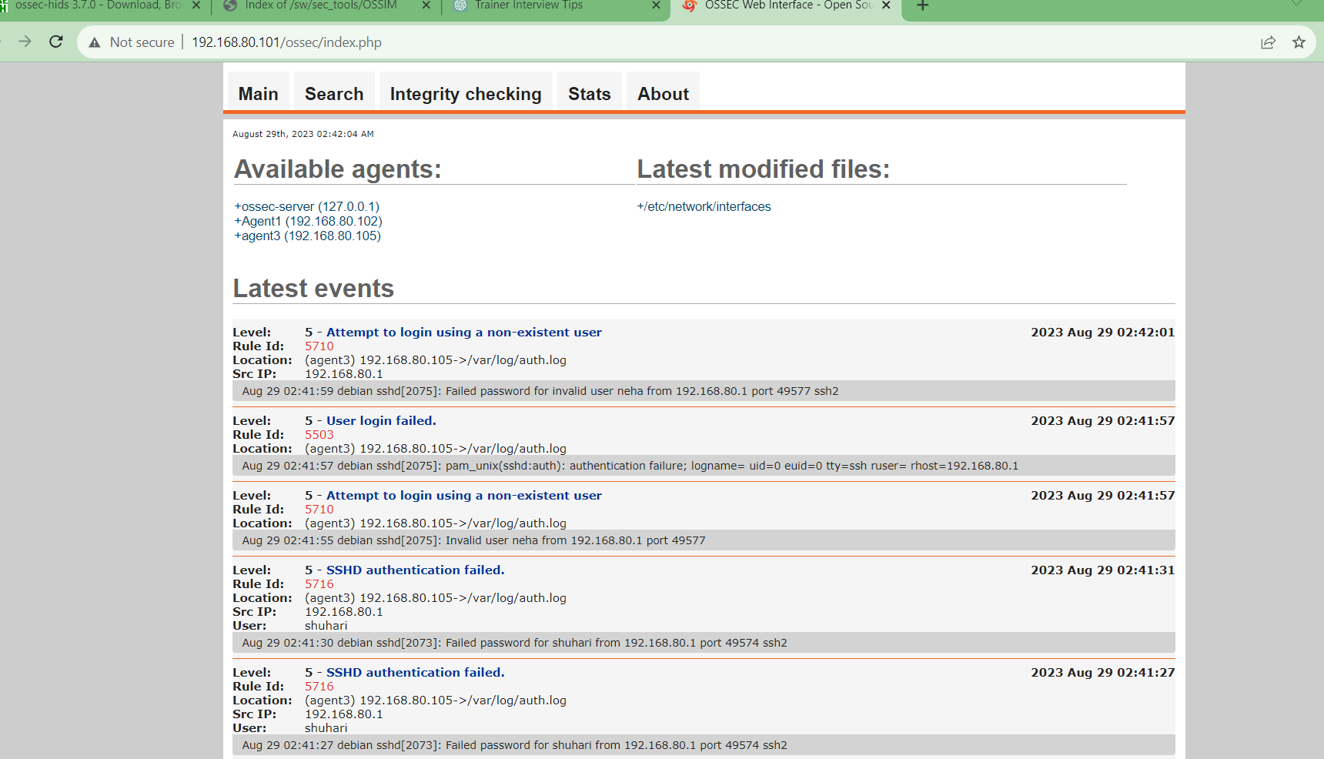
Ossec server-agent setup

Slide 9
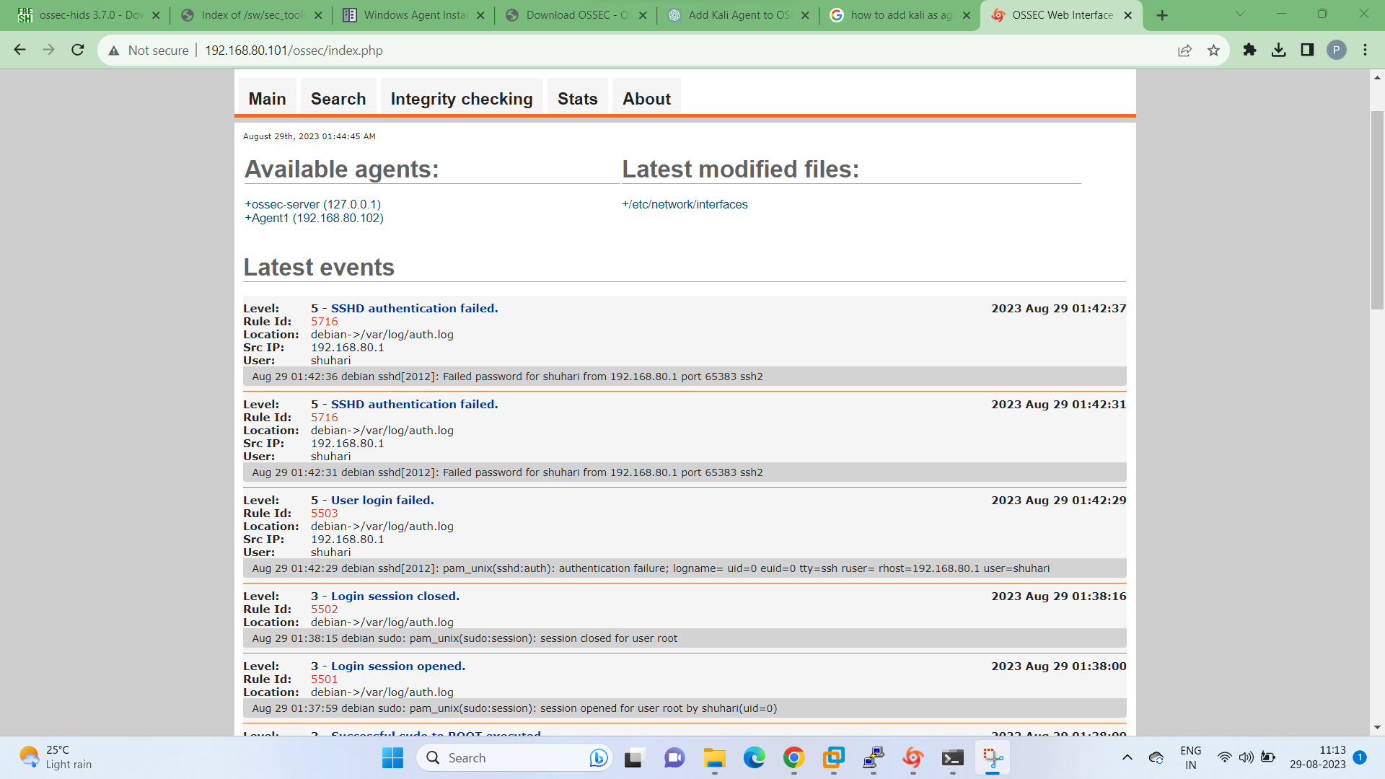
Authentication logs

Slide 10
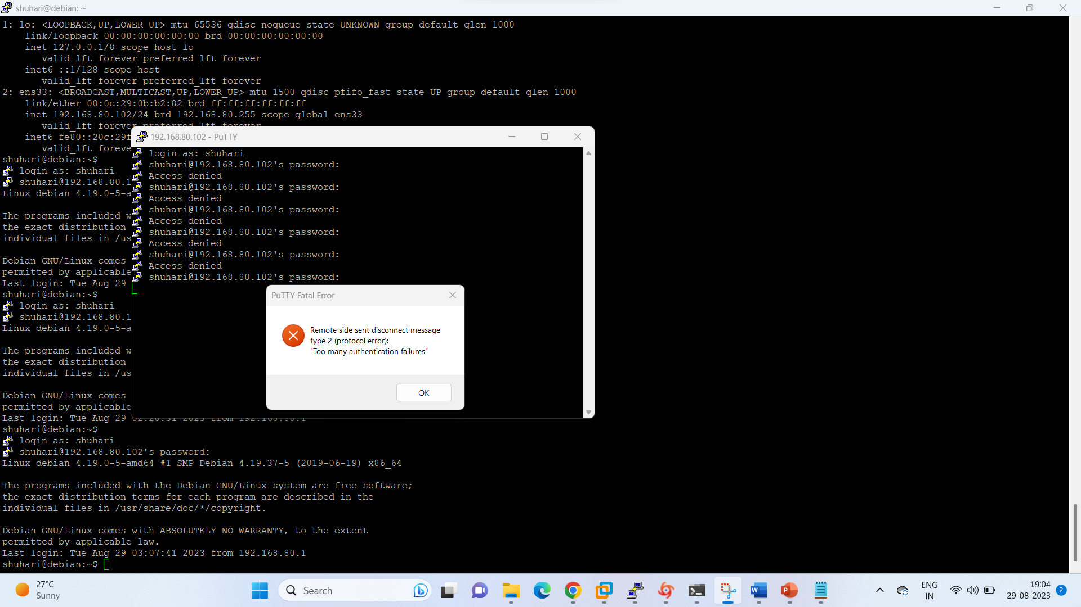
Authentication failed

Slide 11
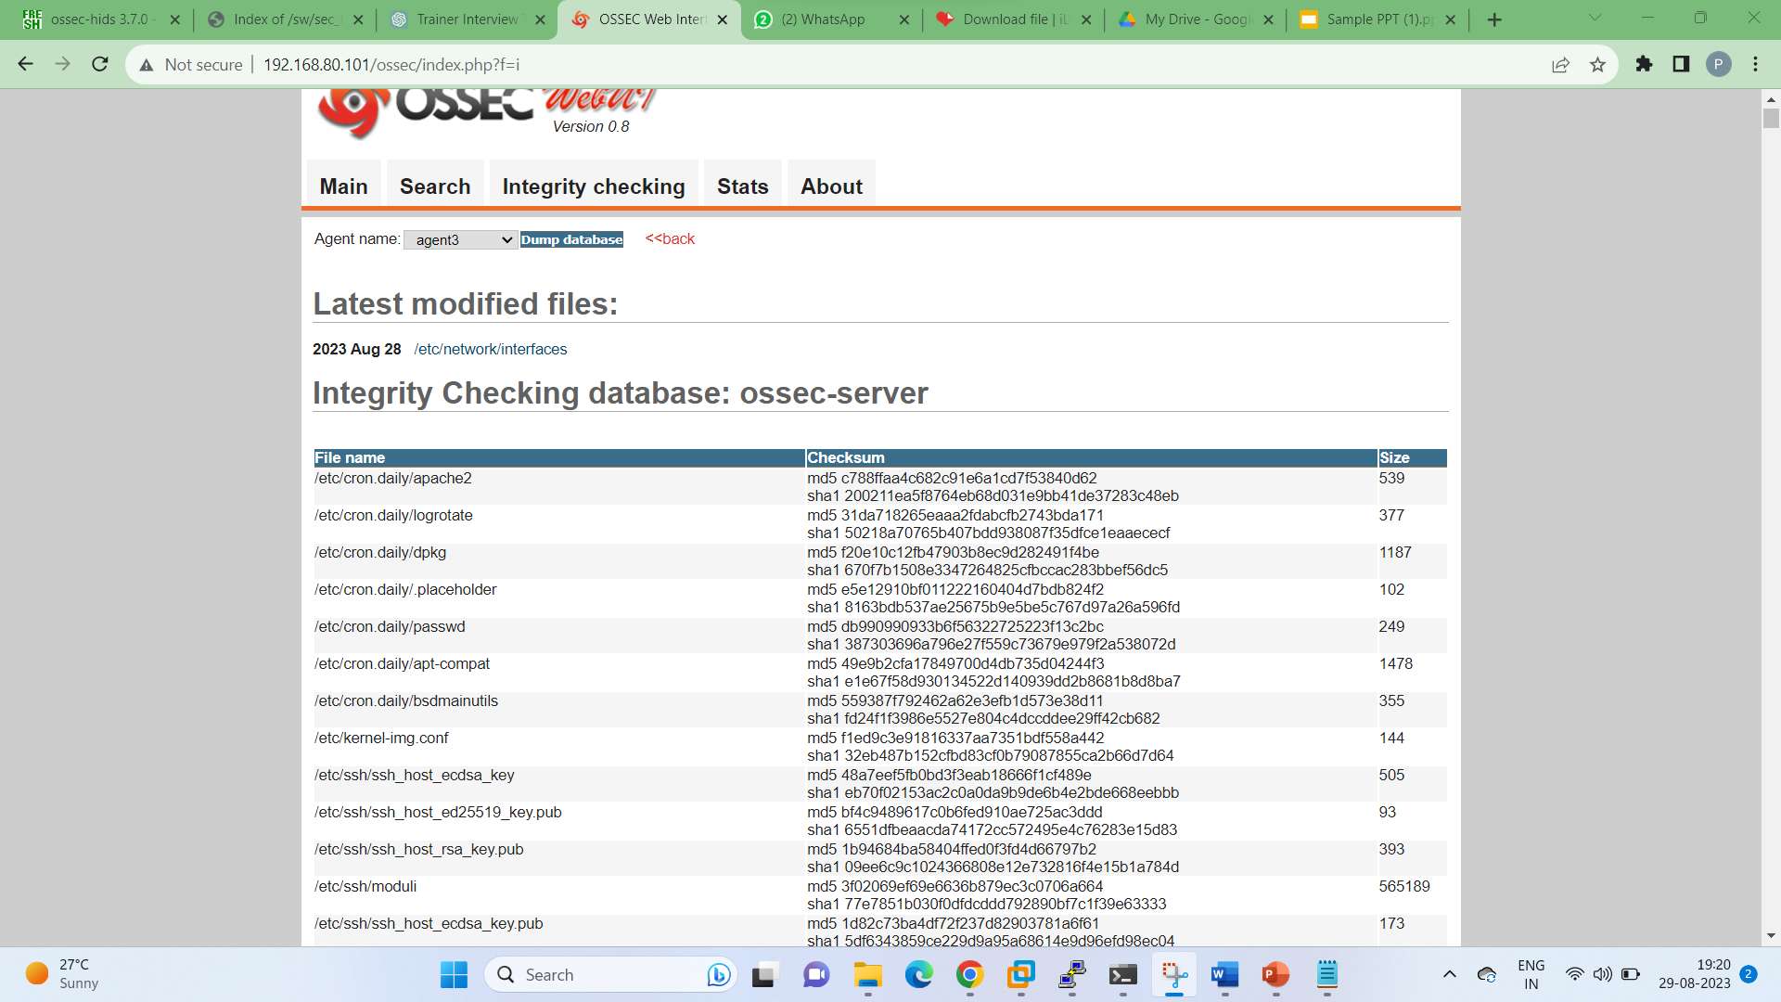
Integrity checking

Slide 12
Hids advantages
A HIDS agent has the capability to monitor all network traffic destined for it on all interfaces on the system.
It gives security operators the ability to spot and stop an attack on any host
It also has the capability to detect attacks outside your network perimeter.
Agent has the capability to protect your laptop from network traffic that may try to compromise your system through a wireless card.

Slide 13
conclusion
The project successfully implemented a Host-based Intrusion Detection System (HIDS) using OSSEC, contributing to the organization's cybersecurity strategy. The project's methodology, testing, and outcomes underscore the critical role of HIDS in safeguarding individual hosts against cyber threats.

Slide 14
Thank you

